Slide 1
Celestine Azonobi.
What is Business Analysis ?

Slide 2
A professional discipline that identify
vulnerabilities in business and determine
solutions to business problems.
What is Business Analysis ?

Slide 3

Defines business requirements.
Documenting business processes.
Assessing business model.
Identifying vulnerabilities.
Solutions implementation.
Continuous monitoring of results.
Why Business Analysis?

Slide 4
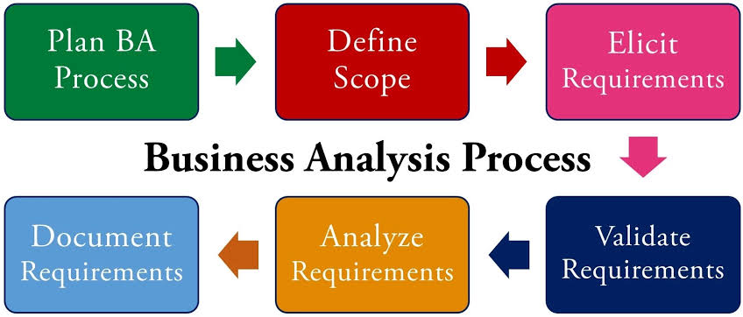
Business Analysis Process

Slide 5
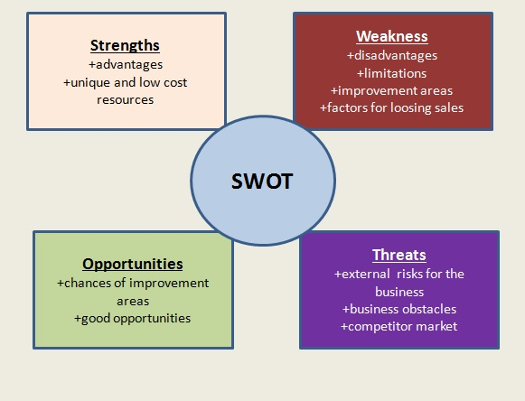
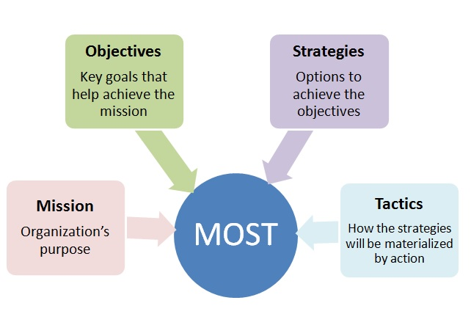
Business Analysis Techniques

Slide 6
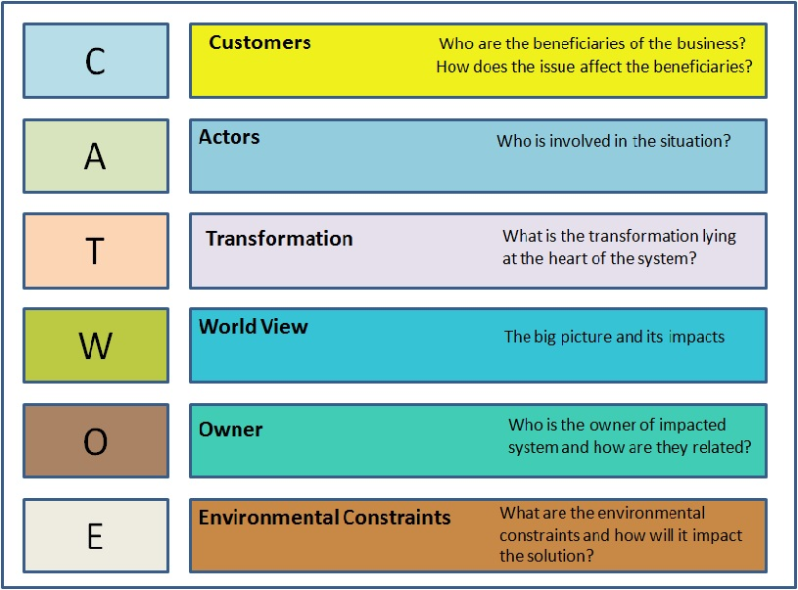
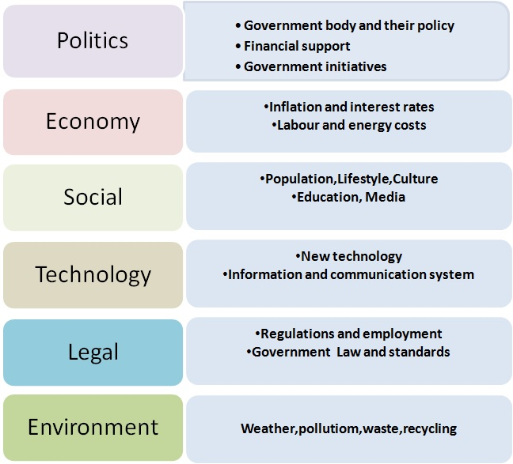
Business Analysis Techniques
PESTLE

Slide 7
END OF SLIDE

